Slide 1
INFORMATION SESSION
Baylor University
Spring 2023
Presented by:
Waleed Chatta
Sierra Trapolsi
Jada Truong
Khoa Nguyen
Tremane Smith
texasjamp.org

Slide 2
What is JAMP?
“The Joint Admission Medical Program (JAMP) is an undergraduate workforce pipeline program created by the Texas Legislature closing the gaps between participation and success for economically disadvantaged Texans pursuing their dreams of becoming a doctor.”

Slide 3
BENEFITS
Support through undergraduate scholarships and summer stipends
Placement into JAMP Summer Internship experiences
Hands-on experience through clinical enrichment opportunities
Comprehensive, multi-phase MCAT preparation program
Personal and professional development through dedicated mentoring
Guaranteed admission to a participating Texas medical school if all criteria are met
Scholarships to attend medical school

Slide 4
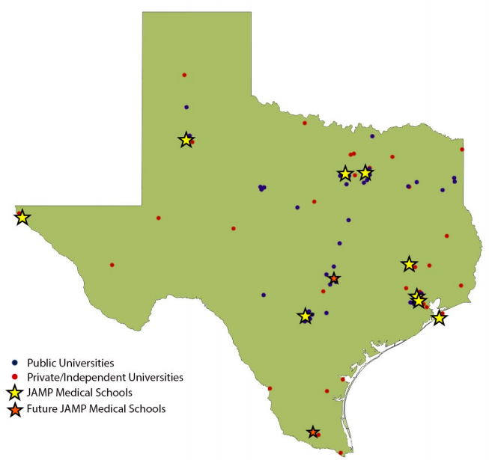
Participating Medical Schools
Baylor College of Medicine
Dell Medical School - The University of Texas at Austin
Long School of Medicine - The University of Texas Health at San Antonio
McGovern Medical School - The University of Texas Health Science Center at Houston
Sam Houston State University College of Osteopathic Medicine
Texas A&M University School of Medicine
Texas Tech University Health Sciences Center - Paul L. Foster School of Medicine at El Paso
Texas Tech University Health Sciences Center - School of Medicine
Tilman J. Fertitta Family College of Medicine at University of Houston
University of North Texas Health Science Center – Texas College of Osteopathic Medicine
The University of Texas Medical Branch (UTMB) John Sealy School of Medicine at Galveston
The University of Texas Rio Grande Valley School of Medicine
The University of Texas Southwestern Medical School
Notes:
There are 15 medical schools in total in Texas. The only two schools not participating in JAMP are the Burnett School of Medicine at TCU in Fort Worth & the University of Incarnate Word (UIW) School of Osteopathic Medicine in San Antonio.

Slide 5
How do I know if I am eligible?
SAT score of 1001 or higher OR ACT score of 20.2 or higher
Expected Family Contribution (EFC) up to 8000 on at least one year’s FAFSA
Must have completed FAFSA
Earn 27 hours of credit during your freshman year
Including two semesters of General Chemistry with associated labs
Earn a 3.25 GPA or higher
Be a U.S. Citizen or Permanent Resident & Texas Resident
For more information: Texas Residency Determination
Enroll in college no later than the fall semester following high school graduation

Slide 6
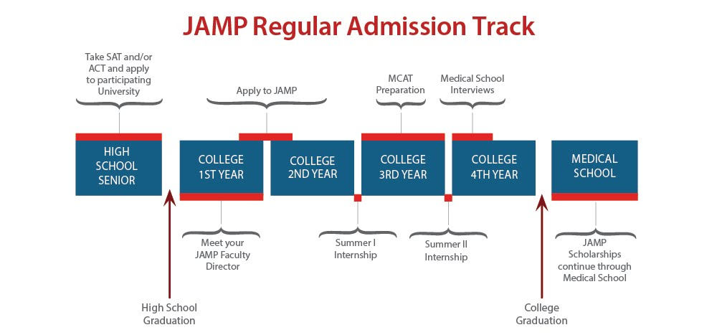
*There is also an Early Admission Track for high school seniors, but Regular Admission is most common

Slide 7
Summer Internships
Summer I:
Anatomy and Physiology lecture + lab
MCAT CARS (Kaplan Prep)
Clinical Preceptorship
Enrichment talks
Summer II:
Biochemistry
Professional Helping Skills
Ethics/Current Issues
Application/Interview Skills
Clinical Preceptorship

Slide 8
Free MCAT Prep
Phase I - Critical Analysis and Reasoning Skills (CARS) Enrichment
During Summer I
Phase II - Science Enrichment in Biology and Chemistry
Fall of Junior year
Phase III - MCAT Preparation
Spring of Junior year
*Additional prep during Summer II if you do not meet the score requirement
Notes:
Disclaimer: This timeline may change in the future with JAMP students gaining greater flexibility on the date they need to take the MCAT.

Slide 9
The MCAT
Minimum MCAT Score:
502
(53rd percentile)
Section score can be no less than 124
Take the test April of your junior year
Update: you can take the MCAT up until August.
***You get a lot of prep, so don’t be intimidated***

Slide 10
Application Overview/Tips
Personal information
Name, address, financial need, etc.
Education
Coursework, educational history, disciplinary action
Extracurriculars and Awards
Leadership, employment, research, volunteering, awards
Essays
Personal Statement
Personal Characteristics Essay
“Optional” Essay
Letters of Evaluation
One from your JFD (Ms. Lin)
One from a University Faculty
Other Supporting Documents
High school & college transcripts
SAT/ACT score documentation
Student aid reports (FAFSA)
OVERVIEW

Slide 11
Application Overview/Tips
A lot like the TMSDAS application
You are applying to JAMP, not medical school quite yet! Keep this in mind when writing your essays
Be honest
Don’t lie about your grades or disciplinary actions
Follow the instructions
When it says to list everything, list everything
Do not list an activity more than once in the extracurriculars section
Start early
It takes a long time to develop a well-written personal statement
Professors are busy, make sure they have enough time to write your evaluation
Getting transcripts from high school may take time
Tips

Slide 12
Applications open May 1st!
Contact Ms. Lin at Jane_Lin@baylor.edu
ASAP to request a meeting for your
JFD Evaluation Form!
Application Deadline is October 31, 2023 by 5:00 PM CST
No exceptions
It comes up quicker than you think!

Slide 13
Helpful Links
Detailed, step-by-step application instructions:
Application Instructions
Criteria Overview:
How to Become a JAMPer
Contact JAMP:
info@texasjamp.org
Have more questions for us?
Email Matthew (Matthew_Mallinson1@baylor.edu), or Waleed (Waleed_Chatta1@baylor.edu) for some student perspectives
Email your JFD, Ms. Jane Lin (Jane_Lin@baylor.edu), for getting the required evaluations and transcripts together
“Making the path to medical school a reality for Texans since 2003.”
- JAMP
Images from texasjamp.org

